Slide 1
FROM BITSTREAMS TO BUNNIES:
HOW TO GO MARIE KONDO ON THE VRAM BY BAKTASH ABDOLLAH-SHAMSHIR-SAZ

Slide 2
THE MOST IMPORTANT RULE
Marie Kondo is well known for this most simple rule: does it spark joy?
This actually applies to memory optimization on the GPU.
How to read this if you’re designing data streams:
Do you need this (bit) to achieve the desired effect (joy)?
Or could this be inferred from the surrounding environment?
Memory reads are expensive.
So let’s only keep things that spark joy. We can infer the rest.

Slide 3
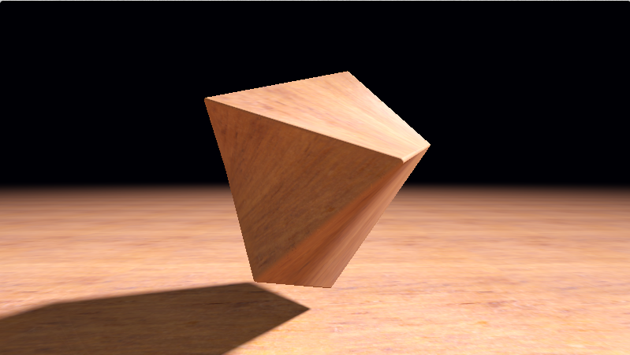
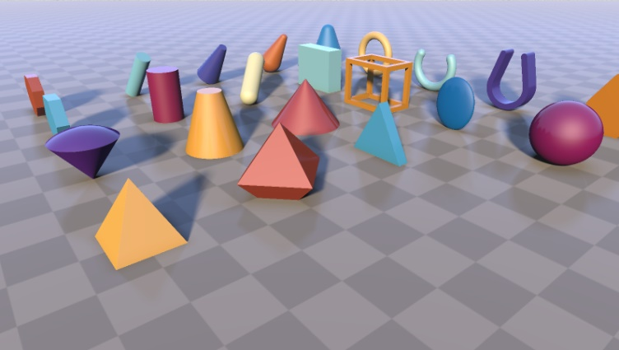
CHALLENGE #1
ShaderToy is a great platform for visualizing analytical expressions (implicit surfaces, analytical bilinear patches etc.)
https://www.shadertoy.com/view/3tjczm by Inigo Quilez
https://www.shadertoy.com/view/Xds3zN by Inigo Quilez

Slide 4
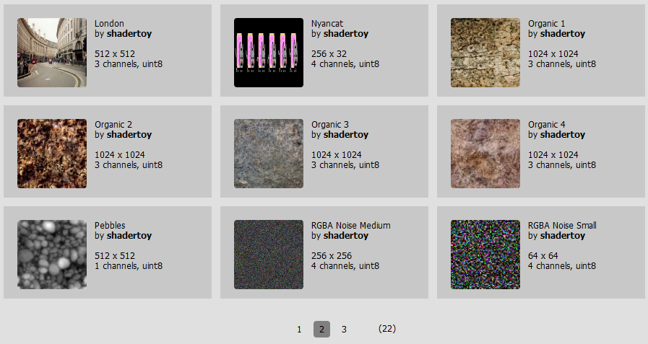
CHALLENGE #1
However, you cannot bring in external images
You’re limited to a pre-selected group of images

Slide 5
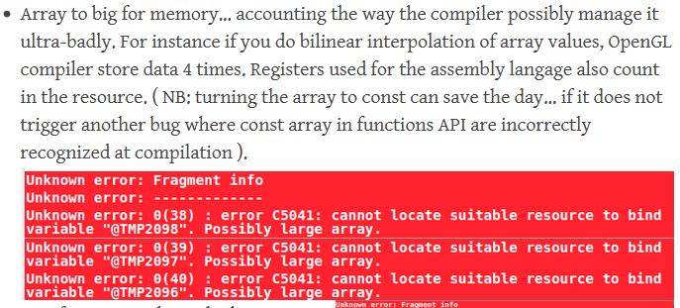
CHALLENGE #1
If you try to bring in contraband data via large arrays:
Generally, you should be able to go as large as 4096 array elements.
However, some compilers – specifically nVidia OpenGL backends for ANGLE on Linux/Android/macOS – will explode as they erroneously allot 4x the amount of memory/registers necessary for accessing said data.
Thus, reducing your cross-platform capacity to 1024 array elements.

Slide 6
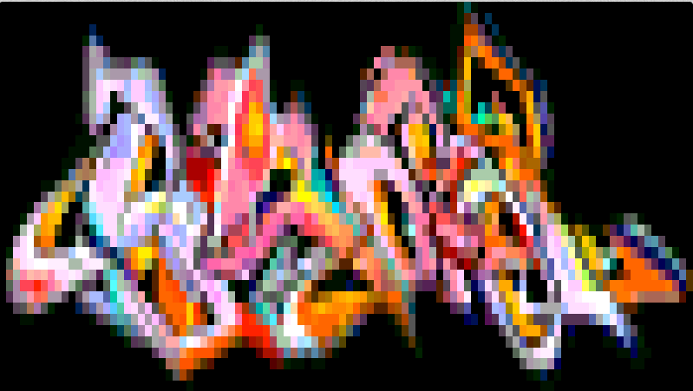
EXAMPLE #1
Say we want to encode the following RGBA8 image:
Do we need all 32 bits to represents this?
Could we just keep RGB8 and color key the rest with black?
Could we go further and crunch down RGB8 to R2G4B2 and spend 1 byte per pixel along with the color key?
Yes and yes!
And the color representation won’t be nearly as bad as it will be uniformly applied

Slide 7
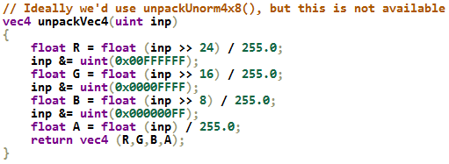
EXAMPLE #1
(We get the image we want in-shader working for all platforms!)
https://www.shadertoy.com/view/tltGWf
(By yours truly)
Necessary util (will not exist everywhere):

Slide 8
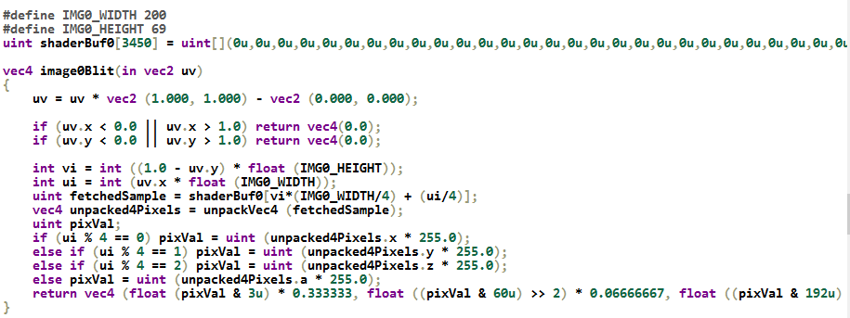
EXAMPLE #1
How to use?
Read entire unsigned int containing the byte we’re interested in
Expand the byte into 3 component color

Slide 9
EXAMPLE #2
Replicating old school Angels cracktro (Shadow of the Beast II on the Amiga)

Slide 10
EXAMPLE #2
If we quantize the colors to R2G4B2 we lose the fidelity on the grayscale metallic texture
Can we keep that and make an exception about the blue?
Thus staying in 1Bpp and maintain fidelity?

Slide 11
EXAMPLE #2
Encode 1Bpp grayscale but keep the blue part a constant low luminance
Luminance scaled x4

Slide 12
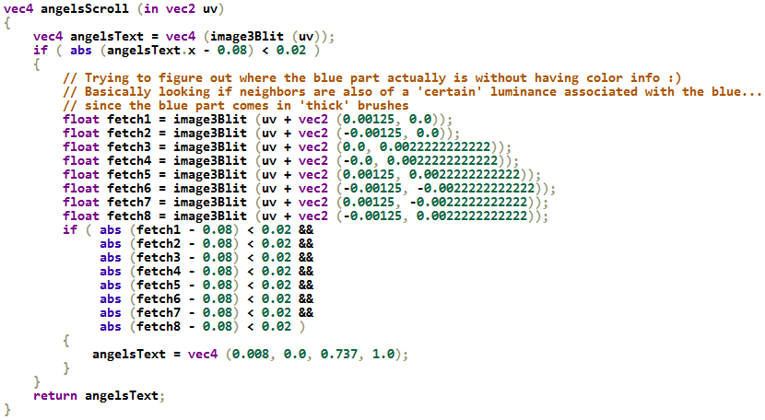
EXAMPLE #2
If we check center luminance…
… and it’s the (low) magic number…
… and all neighbors also have the magic number…
… we can infer that it’s blue!

Slide 13
EXAMPLE #2
https://www.shadertoy.com/view/WljSR1
(By yours truly)
We have sparked joy!
(by inferring from circumstantial information)

Slide 14
EXAMPLE #3
Can we replicate the Psygnosis owl? (R.I.P Ian Hetherington)

Slide 15
EXAMPLE #3
Our options:
In-shader SVG renderer:
Will be slow
Will use a lot of floats and registers
Leverage what we have:
1 Byte per pixel
Is this really necessary?
Can we do better? The owl can be just a black and white stencil:

Slide 16
EXAMPLE #3
We can do literally 1 bit per pixel:
And also maintain a rather high resolution

Slide 17
EXAMPLE #3
Apply 3x3 AA when sampling
Add colors and patterns strategically
And voila!

Slide 18
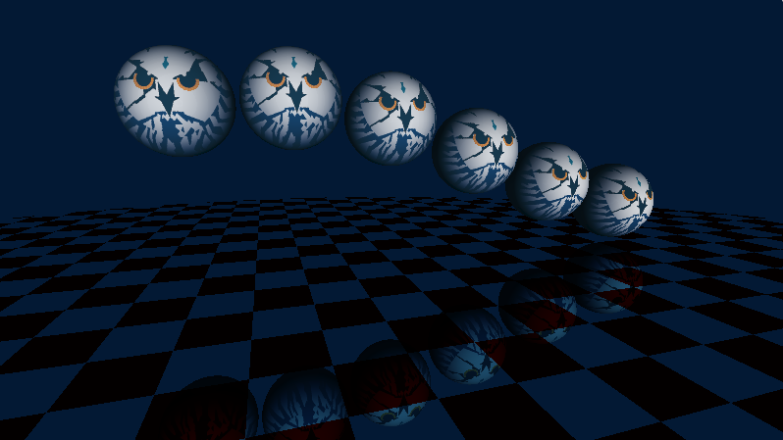
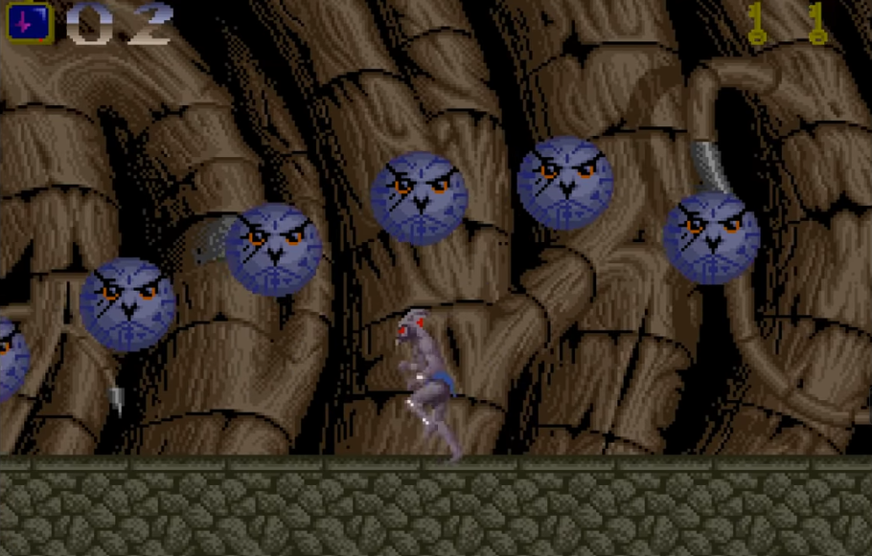
EXAMPLE #3
End result: https://www.shadertoy.com/view/3lBSzK (By yours truly)
Homage to this scene from Shadow of the Beast I

Slide 19
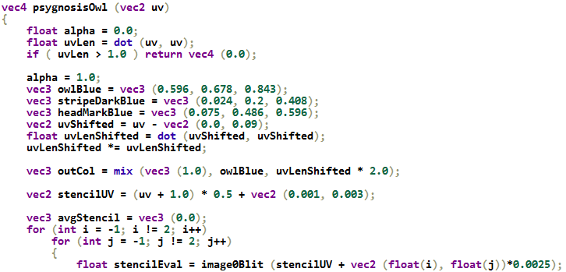
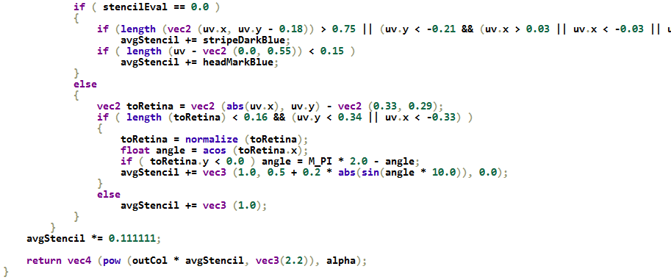
EXAMPLE #3
Stencil decode is much simpler
Just 1 bit we’re interested in
Image reconstruction is much more involved:

Slide 20
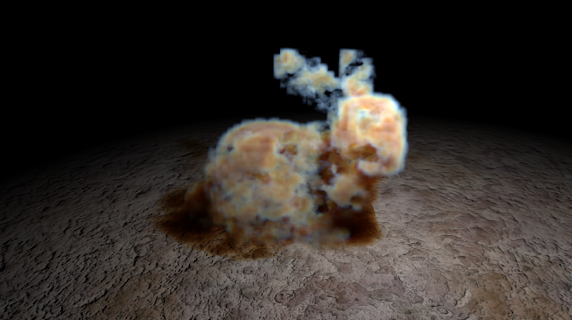
CHALLENGE #2
What about geometry?
Example:
The Stanford bunny
Used by Sebastien Hillaire to demonstrate improved delta-tracking integral (https://www.shadertoy.com/view/MdlyDs)
Coarse around the ears:
Can we do better?

Slide 21
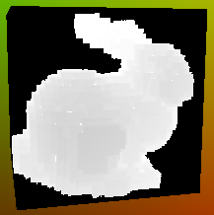
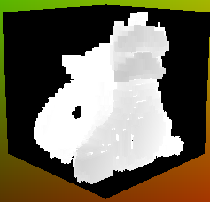
CHALLENGE #2
Yes, we can!
Encode entire geometry as a Sparse Voxel Octree
Waste no bits on empty top and mid-level bricks
You can trace this, live!
We packed the bunny and had room for 2 more!
https://www.shadertoy.com/view/dlBGRc (By yours truly)

Slide 22
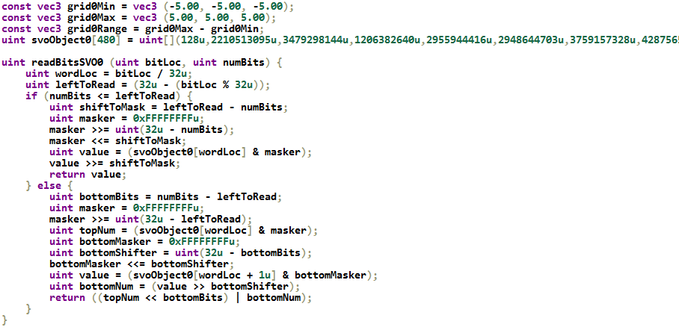
CHALLENGE #2
For this we actually need a bitstream reader:

Slide 23
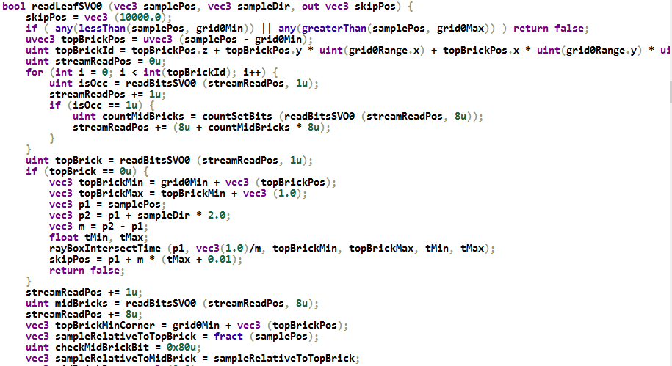
CHALLENGE #2
Live trace via hole-skipping ray-box (slab) intersection tests:

Slide 24
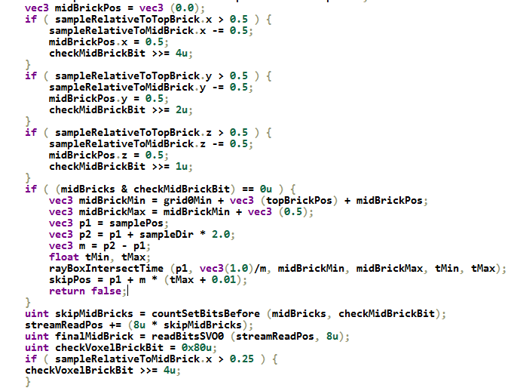
CHALLENGE #2
Read octree nodes only if they’re occupied (i.e. encountered a set bit).
Otherwise, skip the size of the level you’re at (top or mid-level brick):

Slide 25
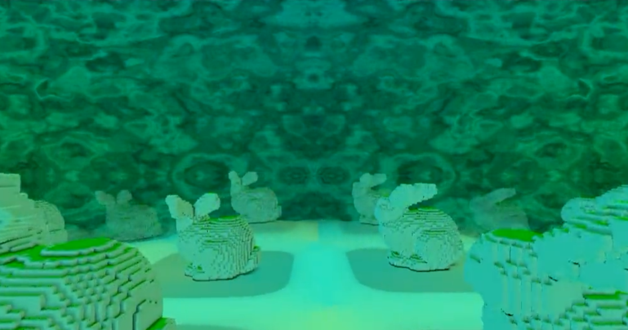
CHALLENGE #2
Does this work at scale?
Turns out: no (lol!)
First attempt by yours truly to combine with SDFs
Too slow
Pros:
Smooth corners
Cons:
Too many reads (3x3x3 fetches to construct a local rounded box SDF)
All value in hole-skipping gone

Slide 26
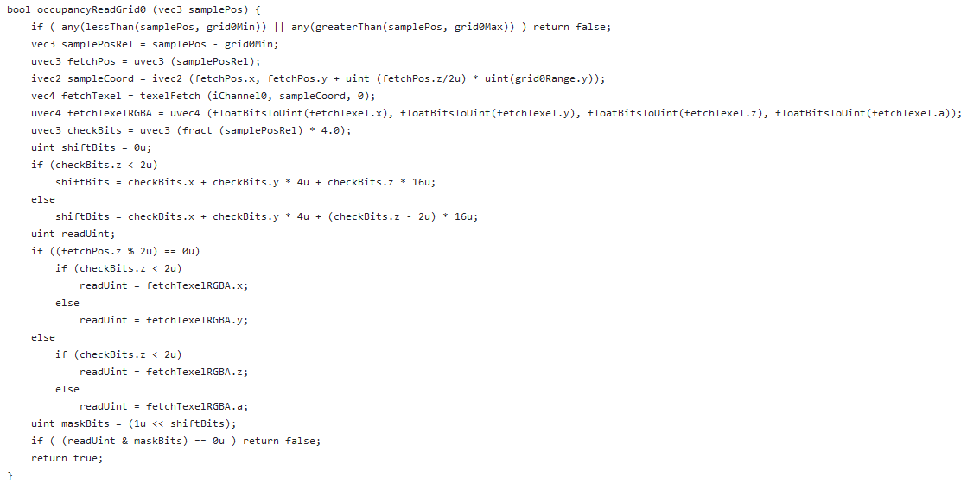
CHALLENGE #2
Code available on Shadertoy-utils (by yours truly):
https://github.com/toomuchvoltage/shadertoy-utils
Below code executed 3x3x3 times! (Oof…)

Slide 27
CHALLENGE #2
Second attempt:
Encode the entire bunny as a distance field
Three step approach:
Expand SVO into tiles in a sub-region of a floating point target
Generate distance field via JFA
Keep going until offsetPower is -1.0
Compact SDF output to use as little memory as possible
40x40x40 bunny only needs a (40, 40*3) RGBA32F sub-image

Slide 28
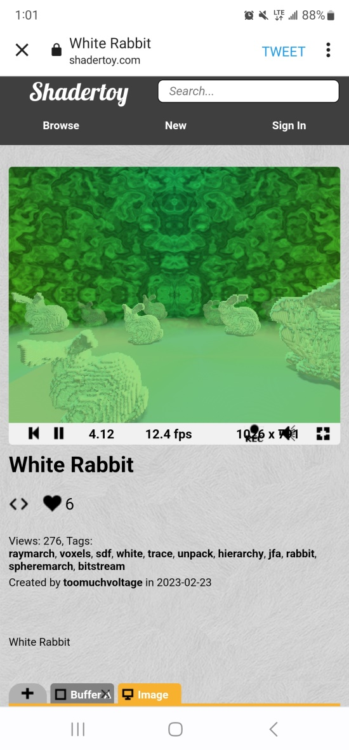
CHALLENGE #2
Bingo!
Even runs on my phone: S22 Ultra
https://www.shadertoy.com/view/cs3GRH (By yours truly)

Slide 29
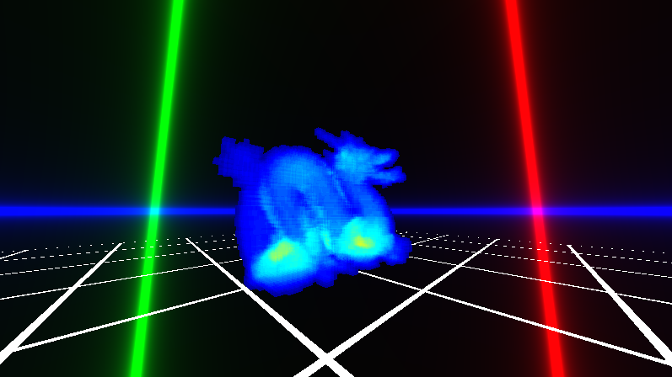
CHALLENGE #2
Honorable mention:
RLE encoded Stanford dragon by Anton Schreiner
https://www.shadertoy.com/view/tlSSWD
There is no option to live-trace here though! (would be too slow)
Expanded version would not hole-skip either.

Slide 30
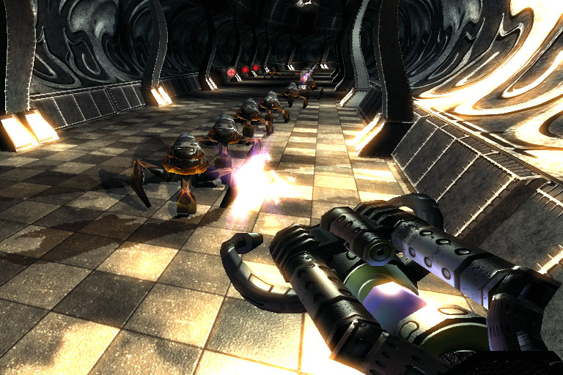
CHALLENGE #2
Have we seen this sort of runtime expansion before?
Yes: .kkrieger by .theprodukkt
Entire video game in <100KB
All geometry is CSG
All textures are encoded as successive brush strokes
Expanded into VRAM at runtime

Slide 31
CHALLENGE #2
NOTE: if you want to ship materials with the bunny, encode as swatch bits following the leaf brick bits
We can access them as we encounter intersections
Another rule by Marie Kondo:
Store items based on frequency of use!
In GPU optimization this is spatial locality for spatially coherent access
Results in less cache thrashing

Slide 32
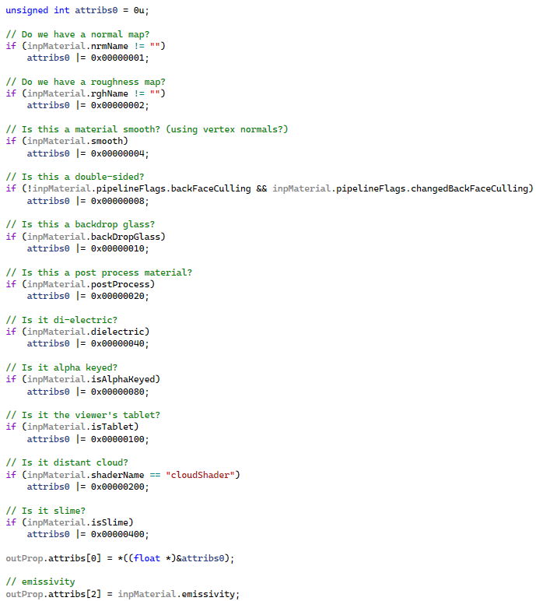
CHALLENGE #3
What about games? Can this help our title?
Yes!
Encode instance properties in your instance property buffers (UAVs/SSBOs) as bits in a bitfield

Slide 33
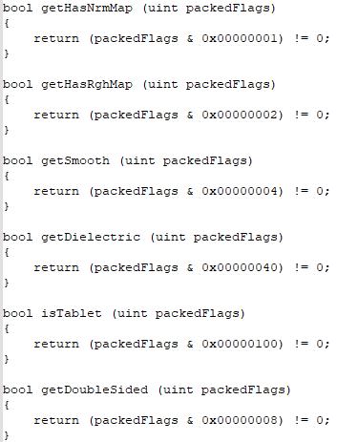
CHALLENGE #3
Decode inside shader

Slide 34
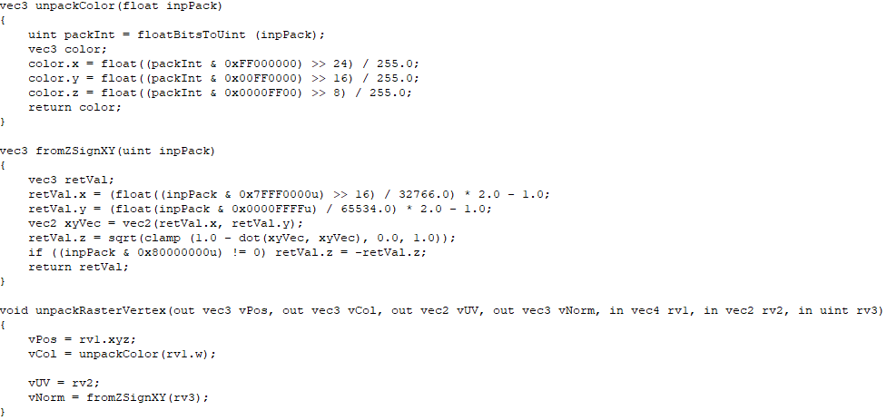
CHALLENGE #3
What else?
We can pack and unpack data into vertices so as to push more geometry
We can store normal as sign of Z, X and Y and infer via sqrt

Slide 35
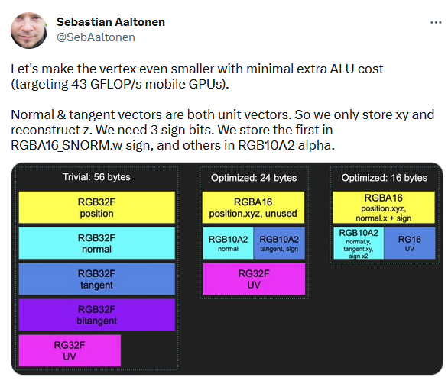
CHALLENGE #3
Try hard enough and you should hit 16 bytes per vertex! ;)
https://twitter.com/SebAaltonen/status/1515735247928930311

Slide 36
CHALLENGE #3
Vertex positions in Ryse: Son of Rome were compressed to represent a fraction of the mesh AABB:
Presentation missing from the web
But instructions on how to do this in CryEngine is available here: https://docs.cryengine.com/display/CEMANUAL/Geom+Cache+Technical+Overview
Entire tangent space was also encoded as a quaternion with some additional info. See q-tangent: https://dl.acm.org/doi/abs/10.1145/2037826.2037841

Slide 37
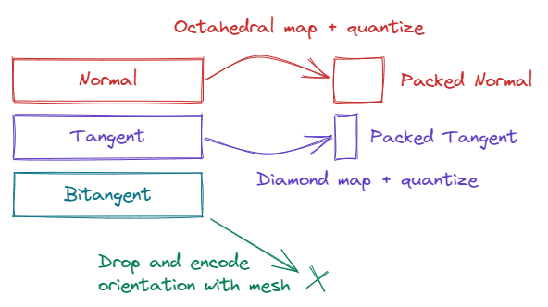
CHALLENGE #3
Even more compact tangent space representation:
https://www.jeremyong.com/graphics/2023/01/09/tangent-spaces-and-diamond-encoding/

Slide 38
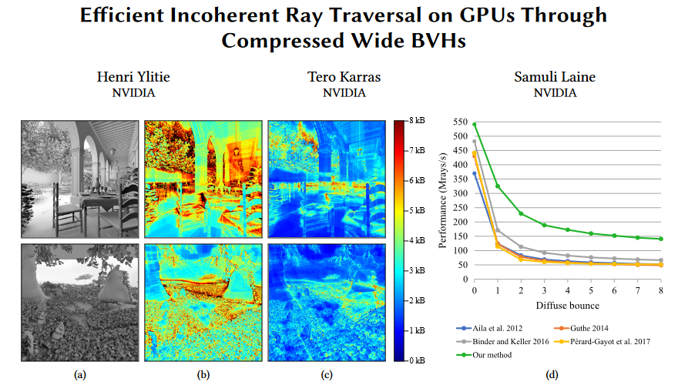
CHALLENGE #3
This is efficient in path-tracing too!
Ylitie2017 not only encodes vertex positions as fractions of leaf AABBs, but makes internal node AABBs fractions of each other:
https://research.nvidia.com/sites/default/files/publications/ylitie2017hpg-paper.pdf

Slide 39
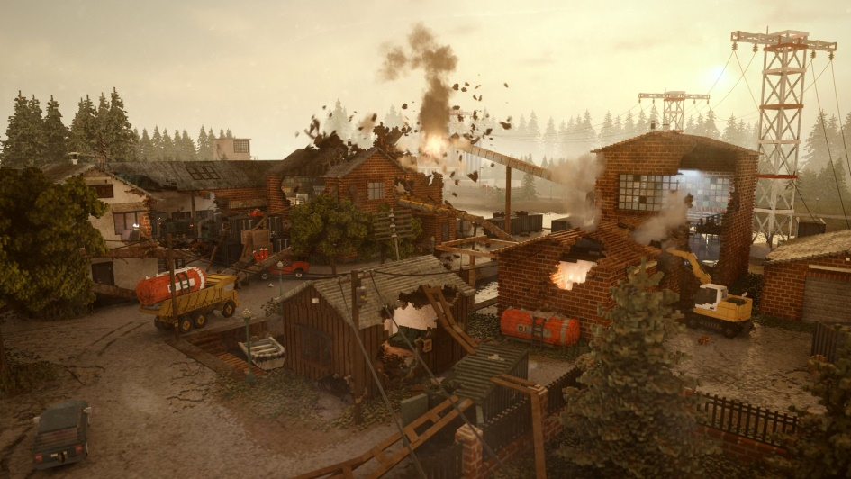
CHALLENGE #3
Every leaf node in Teardown uses an 8-bit index to look into a color palette:
Full tech talk here:
https://www.youtube.com/watch?v=0VzE8ROwC58
Many many ways to spark joy!

Slide 40
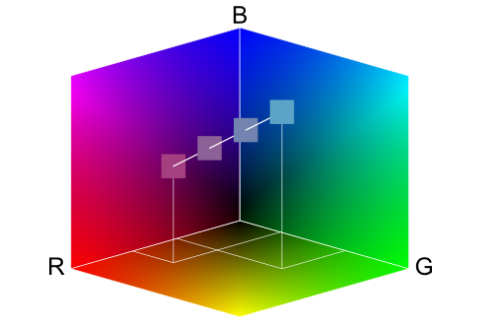
CHALLENGE #3
Even the hardware does this for you!
BC1-7 block compression is all about storing color endpoints and flattening colors as 1Bpp fractions on the line that forms
https://www.reedbeta.com/blog/understanding-bcn-texture-compression-formats/

Slide 41
THAT IS ALL!
Thank you for listening!
Feel free to reach out:
baktash@toomuchvoltage.com @toomuchvoltage

